Slide 1
Airbnb First Destinations
Emily Geller
Notes:
For my project, I’m trying to predict the first destinations for new Airbnb users using their demographics and browsing behavior.

Slide 2


Airbnb First Destinations
New users from USA
Domestic vs International destinations
Build personas
Recommend properties
Market destinations

Slide 3
Data Summary
Features
Target
Sessions
User Id
Action
Action Type
Action Detail
Device Type
Seconds Elapsed
Demographics
User Id
Date Account Created
Timestamp First Active
Date of First Booking
Gender
Age
Signup Method
Language
Affiliate Channel/Provider
Signup App
First Device Type
First Browser
Destination
Domestic
International
Total Users:
62376 Domestic
26532 International
Notes:
sessions and demographics

Slide 4
Data Summary
Features
Target
Sessions
User Id
Engineered Features:
Total Sessions per User
Total Sessions per User on:
Mac
Windows
iPhone
Android
Demographics
User Id
Date Account Created
Timestamp First Active
Date of First Booking
Gender
Age
Signup Method
Language
Affiliate Channel/Provider
Signup App
First Device Type
First Browser
Destination
Domestic
International
Total Users:
62376 Domestic
26532 International
Notes:
target
upsampling

Slide 5
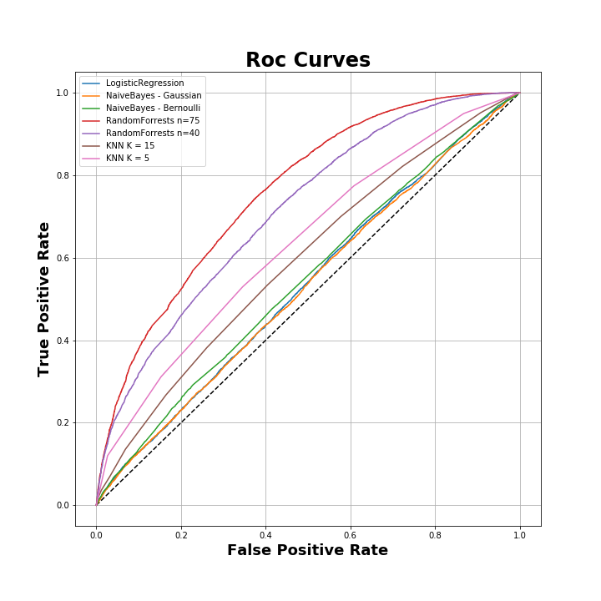
Model Comparison
Random Forests
KNN
Naïve Bayes
Bernoulli
Gaussian
Logistic Regression
Notes:
Upsampling. Cross validation. Grid search

Slide 6
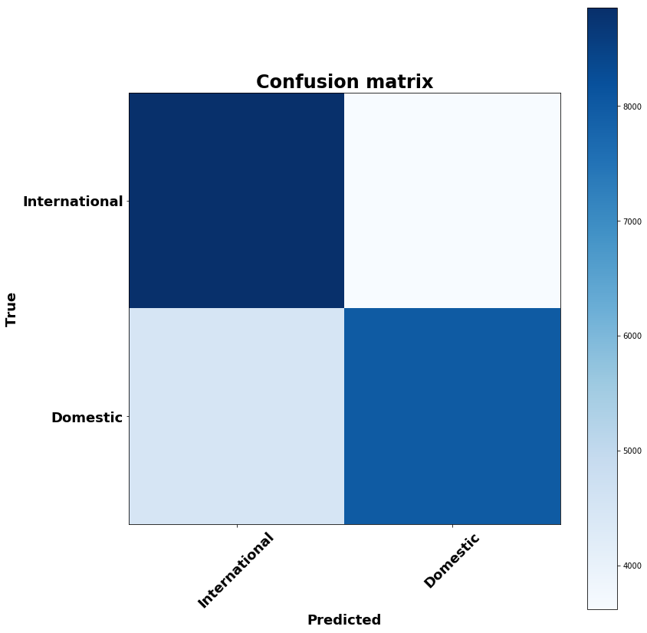
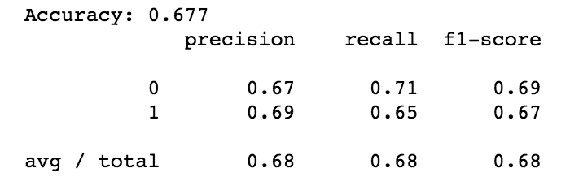
Final Model – Random Forests
75 Trees
Max Depth: 20
ROC AUC: 0.759
Notes:
model has a slight bias for predicting internationally when users are actually traveling domestically
Recall : of all the users who booked internationally, my model found 71% of them
Precision: of all the users that my model predicted to book internationally, 67% of them actually did

Slide 7
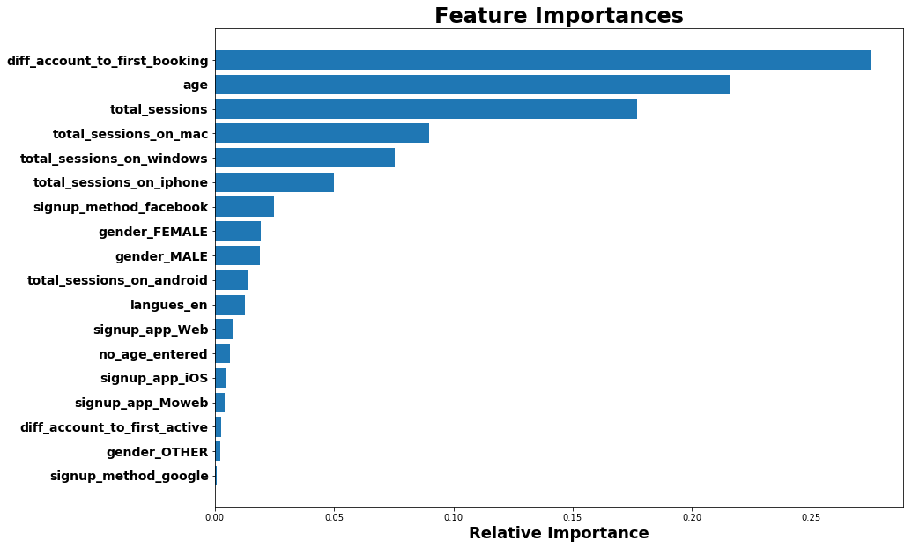
What does the model say?
age_of_account
Notes:
In general, longer time on site before booking => domestic
Older => international
Mac => domestic
Windows => international

Slide 8
Demo

Slide 9
Next Steps
Cost Benefit Analysis
Predict region or country
Sessions features

Slide 10
Questions?

Slide 11
Appendix

Slide 12
Sessions Data
Engineered Sessions Features
Sessions
User Id
Action
Action Type
Action Detail
Device Type
Seconds Elapsed
Total Sessions per User
select user_id, count(1)
from sessions
group by user_id;
Total Sessions per User per Device
Mac example:
select user_id, device_type, count(1) total
from sessions
where device_type = 'Mac Desktop'
group by user_id, device_type;
Notes:
engineering

Slide 13
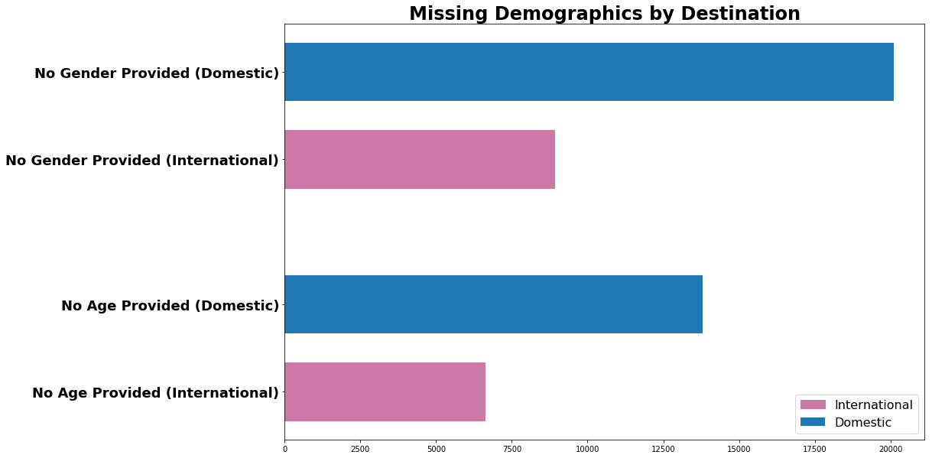
EDA

Slide 14
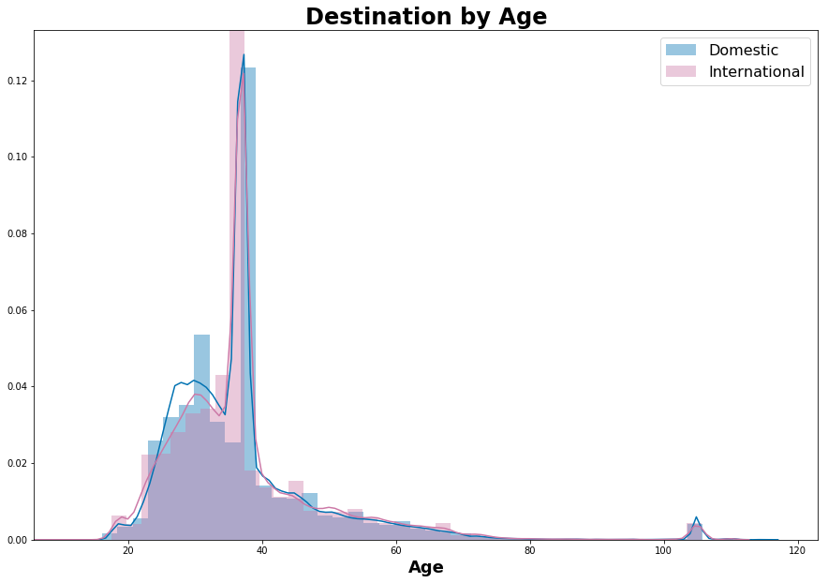
EDA

Slide 15
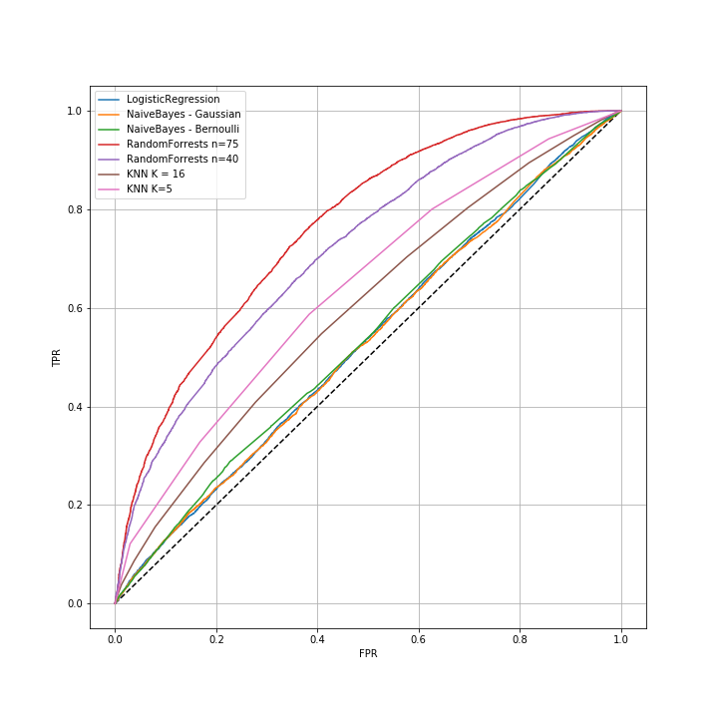
Model Comparison
Rank | Model | ROC AUC | F1 | Precision | Recall | Accuracy
1 | Random Forests n = 75, max_depth = 25 | 0.76 | 0.68 | 0.68 | 0.68 | 0.68
2 | Random Forests n = 40, max_depth = 25 | 0.72 | 0.65 | 0.65 | 0.65 | 0.65
3 | KNN k = 5 | 0.64 | 0.60 | 0.60 | 0.60 | 0.60
4 | KNN k = 15 | 0.59 | 0.57 | 0.55 | 0.57 | 0.57
5 | Naïve Bayes Bernoulli | 0.54 | 0.51 | 0.53 | 0.53 | 0.52
6 | Naïve Bayes Gaussian | 0.53 | 0.41 | 0.54 | 0.51 | 0.51
7 | Logistic Regression | 0.53 | 0.52 | 0.52 | 0.51 | 0.52
Notes:
Upsampling. Cross validation. Grid search

Slide 16
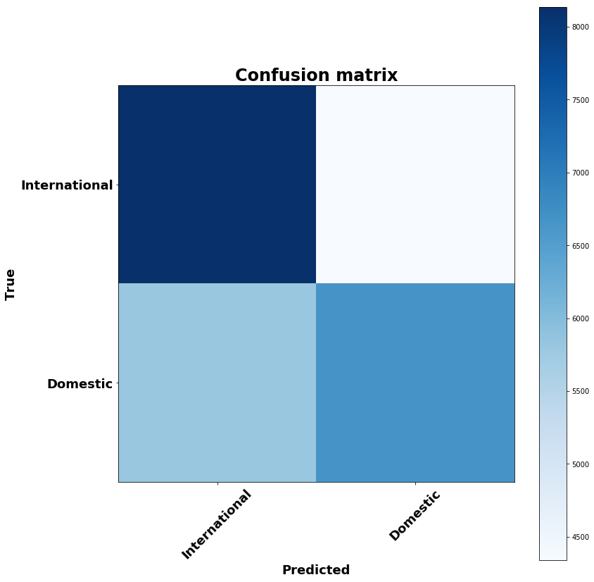
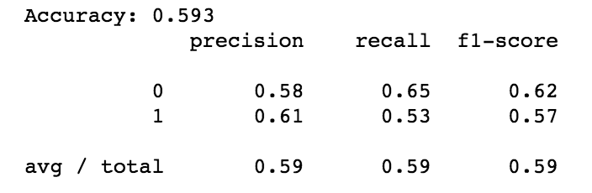
K Nearest Neighbors
ROC AUC: 0.631
Notes:
O

Slide 17
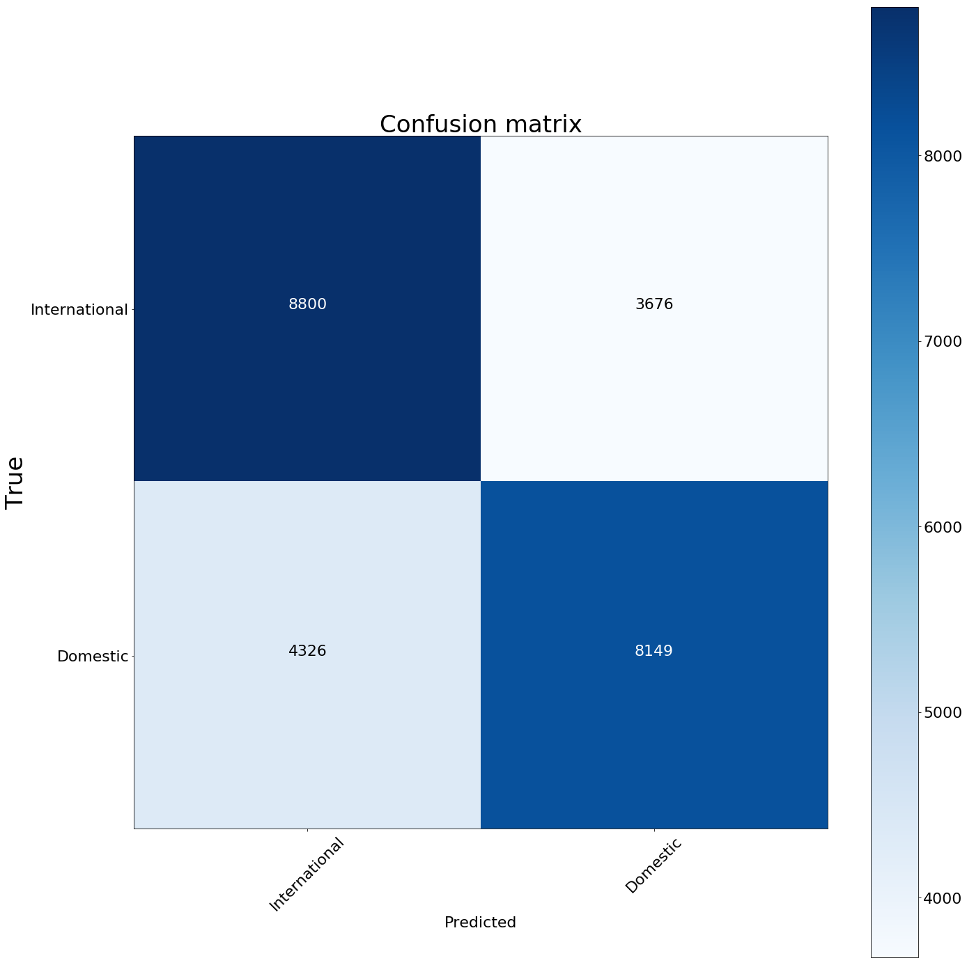
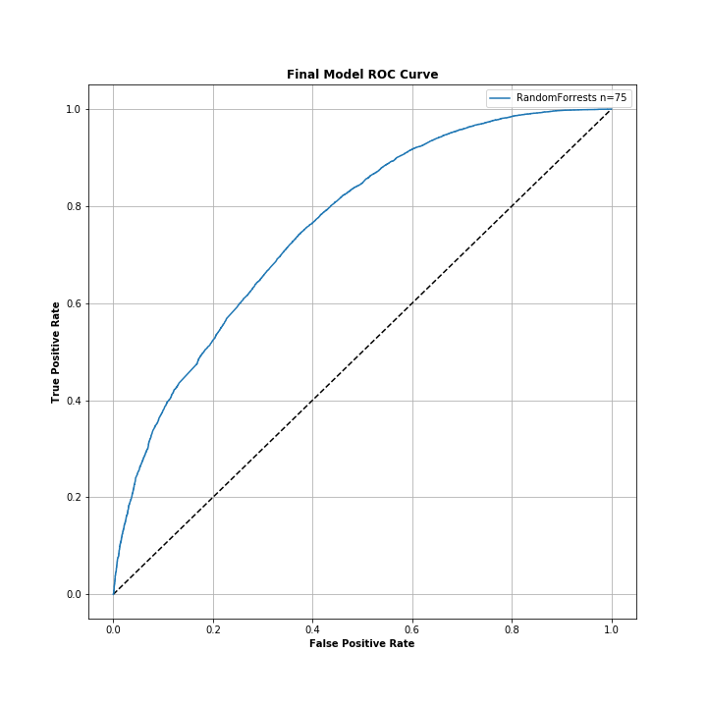
Final Model – Random Forests
Rank | Model | ROC AUC | F1 | Precision | Recall | Accuracy
1 | Random Forests n = 75, max_depth = 25 | 0.76 | 0.68 | 0.68 | 0.68 | 0.68

Slide 18
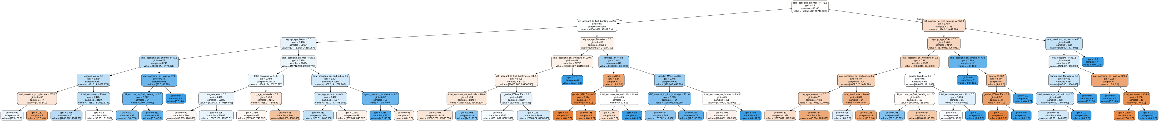
What does the model say?

